Slide 1


Digital Twinning for Geothermal Power Systems
ICELAND: RENEWABLE ENERGY AND SUSTAINABILITY CAPSTONE
Notes:
Peter

Slide 2
Notes:
Peter

Slide 3





United Nations Sustainable Development Goals
Notes:
Peter

Slide 4






Business Model
KEY CUSTOMERS
KEY ACTIVITIES
VALUE PROPOSITION
COST/REVENUE STRUCTURE
Provide real time monitoring and predictions using machine learning and digital twinning.
Digital Twinning has a potential economic impact of 160 billion to 930 billion by the year 2025.
50% Improved Equipment Maintenance
35% Operations Optimization
10% Health and Safety Management.
5% Others
Cost: Cost of hiring a team of engineers
Revenue: Charge customers a flat fee for a basic package and premiums for extra functionality.
KEY RESOURCES
Existing sensors
Existing data
Software Engineers
Site Engineers
Facility Managers
DISTRIBUTION CHANNELS
KEY PARTNERS
Business to business distribution channel in the form of analytics software packages
Notes:
KAT/ Peter

Slide 5
Business Drivers
Key Concepts
Digital Twins
Machine Learning
REAL SYSTEM
VIRTUAL MODEL
DIGITAL
TWIN
Multi Subsystem Model
Notes:
Kat/AHAD

Slide 6



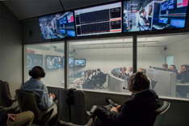



Business Drivers
Formula 1 Racing
Data is collected starting from the Friday practice, which helps set up the car for the race
During the race data is sent in real time to the pit wall, and in the background simulations are run w.r.t the current racetrack and car conditions
The race strategy is dictated based on predictions of the simulations
Post the race weekend, the collected data is fed into predictive models, combined with existing data sets to create new plans and update the models

Slide 7
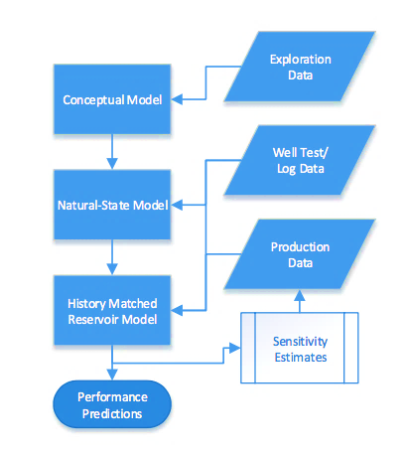
What is currently being done?
Natural State Model
Reproducing the estimated formation pressure, temperature and enthalpies prior to utilization.
Historical Data
Matching the changes of pressure, temperature, enthalpy and chemistry during production.
Predictive Data
Forecasting the future performance of the reservoir. Using sensitivity estimates to decide on further data acquisition
Notes:
AHAT

Slide 8
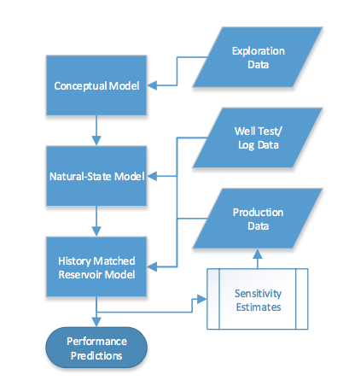
Compare predicted and actual values to update the
models accordingly
Learning Methods
Real Time Data
Notes:
AHAD

Slide 9
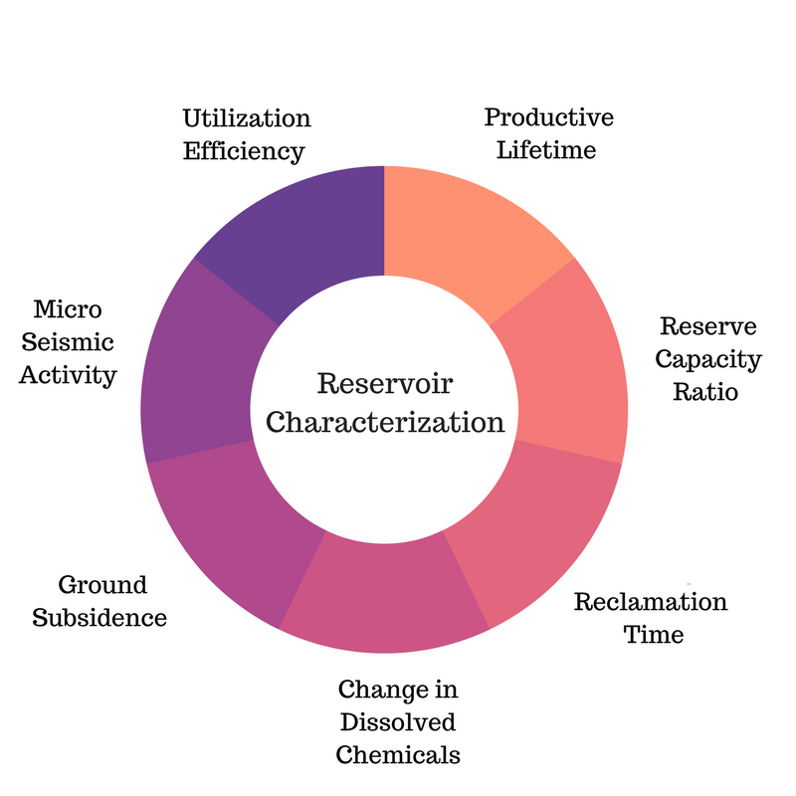
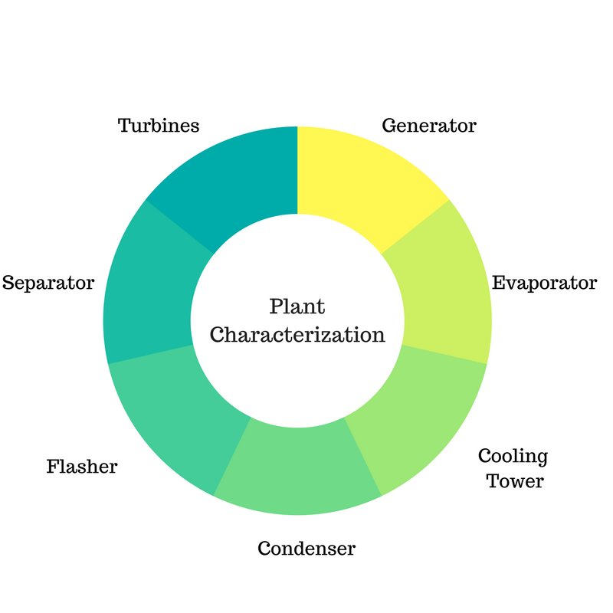
Digital Twin Indicators
PHASE 1
PHASE 2
Source: Sustainability evaluation of geothermal systems in Iceland. Rut Bjarnadottir, 2010.
Notes:
ANDRES

Slide 10
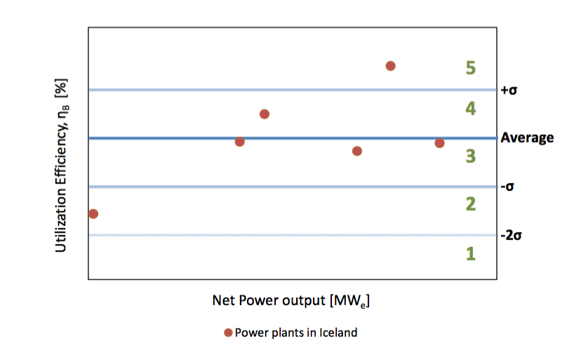
PHASE 1
Efficiency Use
Productive Lifetime
Reclamation Time
Measures how well is the extracted fluid is being utilized.
Requires exergy analysis.
Time that a reservoir can sustain a certain level of production.
Time the reservoir takes, based on pressure and heat, to recover from production.
Production can cause changes in the physical conditions of the fluid in reserve...
Reclamation Time
<
Productive lifetime
Source: Sustainability evaluation of geothermal systems in Iceland. Rut Bjarnadottir, 2010.
Notes:
ANDRES

Slide 11
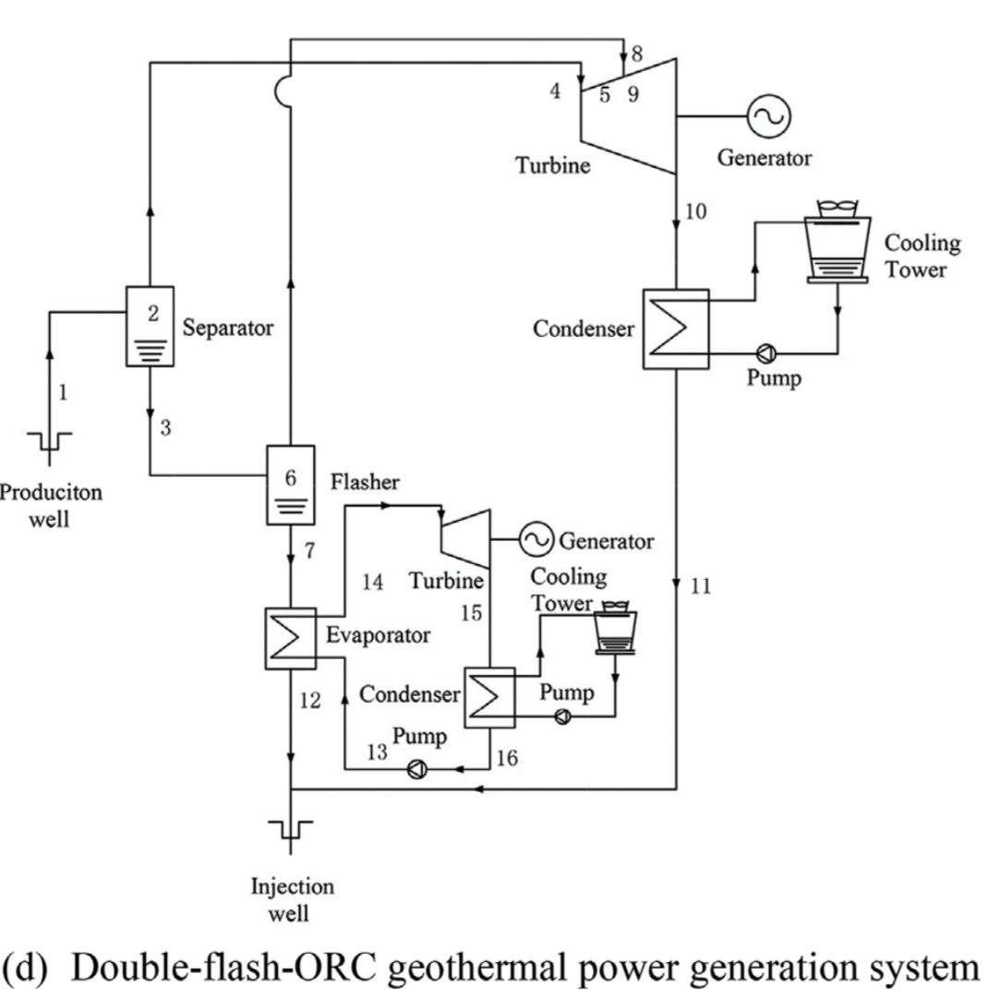
PHASE 2
Process involves high cost machinery and tools
Any failure leads to high costs and non-productive time
Every operational mistake is high cost
The operations have a lot of unpredictability
Models not updated in real time lead to poor performance
What will we offer?
Sensors at each component of the geothermal system to track the performance
Notes:
ANDRES

Slide 12
Sample Features
Geothermal Power Analytics: Calculate important performance metrics such as annual energy production, capacity factor. Give monthly energy production, individual component characteristic, climate data, as well as analyze trends on customer side and production side.
Mean Time Between Failure: Process multiple components from different sources and provide the reliability estimates for each component and analytics about degradation of system over time.
Bayesian Change Detector: Detect anomalies in the time series data - Detect faults in machines by analysis of continuous flow of sensor data produced by the machine.
Failure and Event Driver Identification: Identify the key drivers relevant to the specified event or failure from a large set of attributes and changes that occured in the system. Interplay between reservoir changes and plant failures.
Notes:
KAT

Slide 13
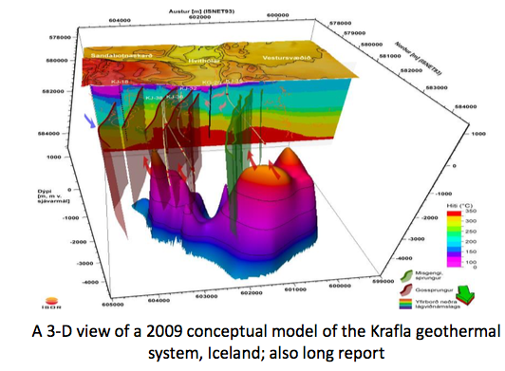
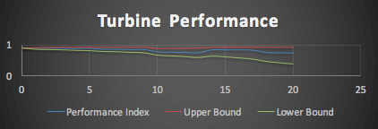
Advantages
Better prediction and increase in performance of the entire system.
Determine failures before they occur both in reservoir modeling and Plant systems such as turbine, separator, condenser and cooling systems.
Notes:
ADVANTAGES

Slide 14
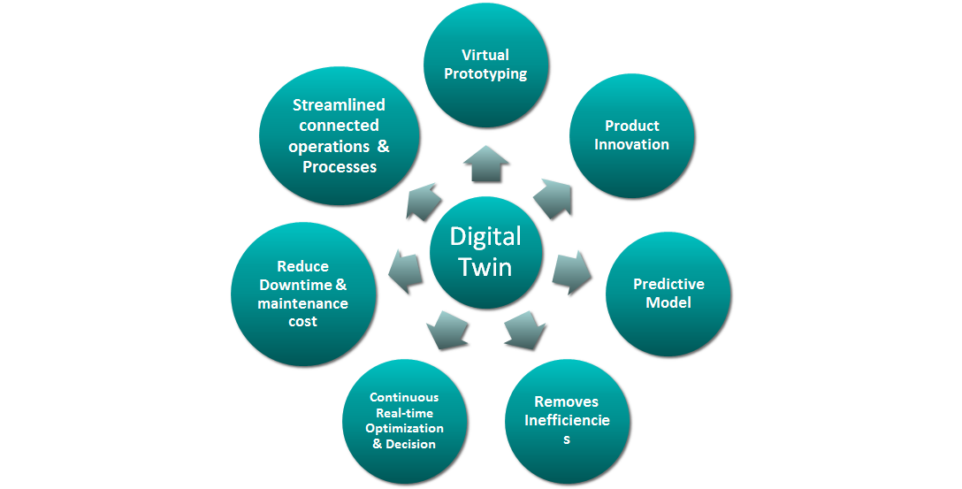
Advantages
Notes:
Ultimately we hope that our system will be able to streamline operations, reduce downtime and maintence costs and increase virtual prototyping, innovation and better predictive models.

Slide 15
Challenges
Data Quality (Need more live data acquisition for accuracy)
Different plant systems have different component and sensors
Different kind of Reservoir characteristics
Funding and resources ( sensors and computing required)
Notes:
Peter

Slide 16
Vision for the Future
We envision a dynamic model that:
Continually collects a significant amount of data about each individual component in order to create a model of that behavior
Implements analytics that use the individual models to derive smart business outcomes by learning from past results and data patterns
Combines modeling and analytics techniques into a platform that simplifies and accelerates their use allowing these capabilities to be easily adapted for new services or other industry applications.
Notes:
KAT

Slide 17
Thank You !
“ A digital twin is a living model that drives business outcome”
(Colin J. Parris, GE)

